Slide 1
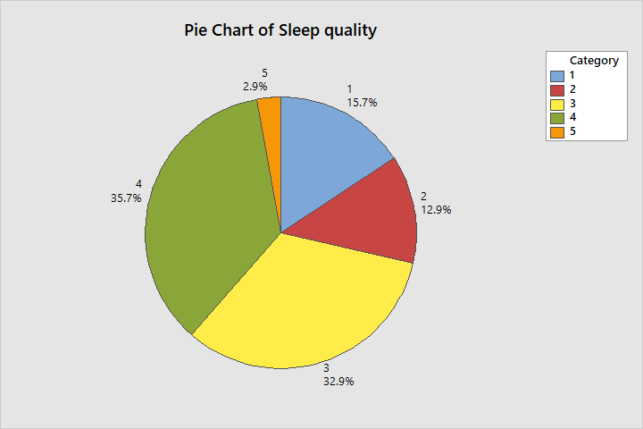
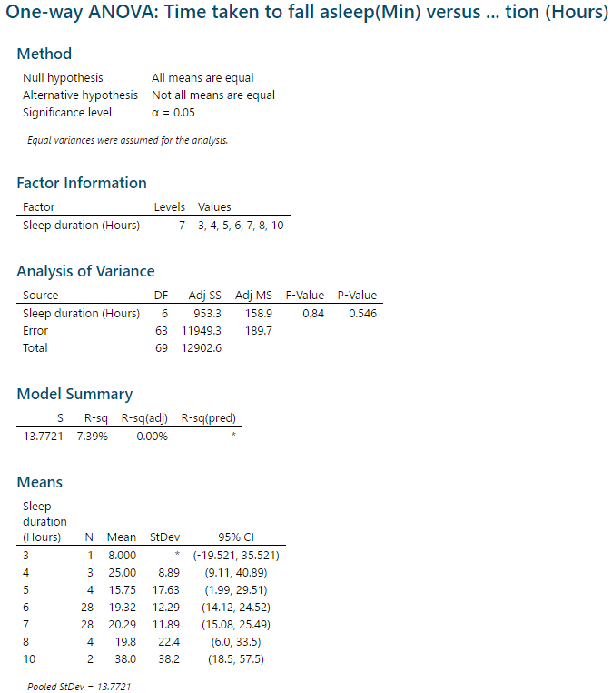
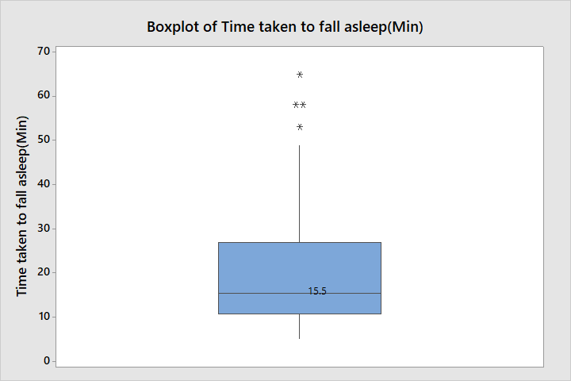
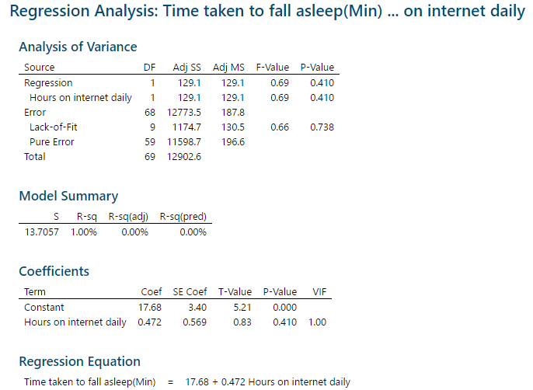
Do teenagers internet usage habits affect their sleeping habits
Lim Chuan Hao(1922264), Gaddiel Lim(1922871), Yeo Sheen Hern(1902257)
DIT/FT/1B/111
BACKGROUND INFO
We were interested in doing this study as being Year 1 DIT students and teenager living in the era of technology and the internet. We wanted to know if it has any affect on our health, especially our sleeping habits. Based on a paper on the effects of sleep on teenagers mental and physiology health, it shows that sleep plays a key role in supporting cognitive function and mental well-being in adolescence.(Tarokh, Saletin and Carskadon, 2016) Also recent studies done on this topic also indicates that teenagers internet habits, mainly internet addiction appears to be related with problematic sleep habits and sleep problems.(Kawabe et al., 2019) Therefore our team’s stance going into the study is that we believe that a teenager’s internet habits does affect their sleeping habits.
This is a pie chart of teenagers perception of their own sleep quality.
With 1 being the worst and 5 being the best quality of sleep, a majority of them(68.9%) rate their sleep being better than average. However, there is also quite a large number(15.7%) rating their sleep to be very bad.
We can see from the boxplot that half of the teenagers actually take less than 15.5 minutes to sleep. This seems to tally with their own perception of their sleep quality and another study(Kawabe et al., 2019) which showed that 77.6% of teenagers took 5-20 minutes to sleep.
However for the other 50%, the time taken to fall asleep has a much larger variation, as seen from length of the box plot. There are even outliers, taking upwards of 1 hour to fall asleep
Context
Q1. What are internet habits
We defined it as the number of hours internet usage in a day.
Q2. What are sleeping habits
We defined it as the number of hours a person slept, time taken for the person to fall asleep and their general.
Q3. Teenagers
We define teenagers as people aged between 16 and 21
Note: We assumed that the daily internet usage in each level was normal, when it may not be to conduct the test. We also assumed equal variance among all daily internet usage sample in each level
This is a regression analysis with the explanatory variable is daily internet usage(hours) and the response variable is time taken to fall asleep.
We can see that based on the analysis, ⍴-test and ꞵ-test, both rejected the null hypothesis as the p-value > 0.05 = 𝛼.
Also we can see that R² = 1% which shows that the variables do not have a linear relationship.
Therefore we can conclude from this analysis that the time taken to fall asleep is not linear related to the daily internet usage of teenagers.
Lastly, we did an ANOVA test with the response variable being the daily internet usage and the factor being the sleep duration of the teenager.
We picked this as the daily internet usage was more normally distributed than sleep duration.
Although this test implies that we are testing if the number of sleep affects the mean number of internet usage, if there were a difference, this could imply that the variables have a relationship.
However, we can see that the p-value of the test is 0.546 > 0.05 = 𝛼, thus the null hypothesis is not rejected.
Therefore the internet usage of teenagers is not affected by the duration of their sleep.
COLLECT DATA
We collect data using a google form that we circulated around our friends and family.
After we collected 150 samples, we filtered to only have results from teenagers which resulted in only 70 entries.
As we collected the data using a survey online we cannot be completely sure of the sampling method.
However as n=70≥30, so the Central Limit Theorem(CLT) applies.
The data we collected and mainly used were:
Daily Internet usage(number of hours of internet used per day)(Continuous)
Quality of sleep(teenager own perceived quality of sleep, 1-5)(Ordinal)
Average time taken to fall asleep(In minutes)(Continuous)
Duration of sleep(Nearest hour)(Ordinal)
However, some variables also did not turn out as we hoped. For example, we expected the daily internet usage, time taken to fall asleep and duration of sleep to be normally distributed but they were not. We also assumed them to be continuous variables, but we ended up treating duration of sleep to be a qualitative variable later on.
Note: We assumed that these variables had a linear relationship, were normally distributed and had constant standard deviation.
MAIN CONCLUSIONS
Overall, our test showed that a teenager’s internet usage habits does not affect their sleeping habits. This is shocking as contrary to a similar paper done on this related issue(Kawabe et al., 2019), we expected that there would be a correlation. However, having said that, we believe that our result may also be wrong. Starting from the collection, the data we collected could have had an unintentional bias to not only Singapore Polytechnic students, but the Diploma in Information Technology(DIT) students. This is as we mainly shared the surveys with people we knew, which could lead to a large majority of them being DIT students. This could effectively skew the results as we mainly use the internet in our study. With the sample size of 70 and us not collecting data on their academic status, we are unable to tell. Therefore, in the future we could sample more teenagers from many different kind of academic streams. Secondly, as we had assumed some conditions for the test we ran, like the linear regression and ANOVA test, this could have caused our results to be affected. We ran the test anyway as we wanted to see the general result it would be as it would be better than not running the test. In the future, we could make sure that all the conditions are met before running the test so that we can have more concrete results. Lastly, we also think that these results may be accurate in a Singapore context. As Singapore’s education system differs quite a lot from the one’s studied in the papers, it could be possible that teenagers in Singapore may not be affected by their internet habits as much.
References
Kawabe, K., Horiuchi, F., Oka, Y. and Ueno, S. (2019). Association between Sleep Habits and Problems and Internet Addiction in Adolescents. Psychiatry Investigation, 16(8), pp.581-587.
Tarokh, L., Saletin, J. and Carskadon, M. (2016). Sleep in adolescence: Physiology, cognition and mental health. Neuroscience & Biobehavioral Reviews, 70, pp.182-188.

